Slide 1
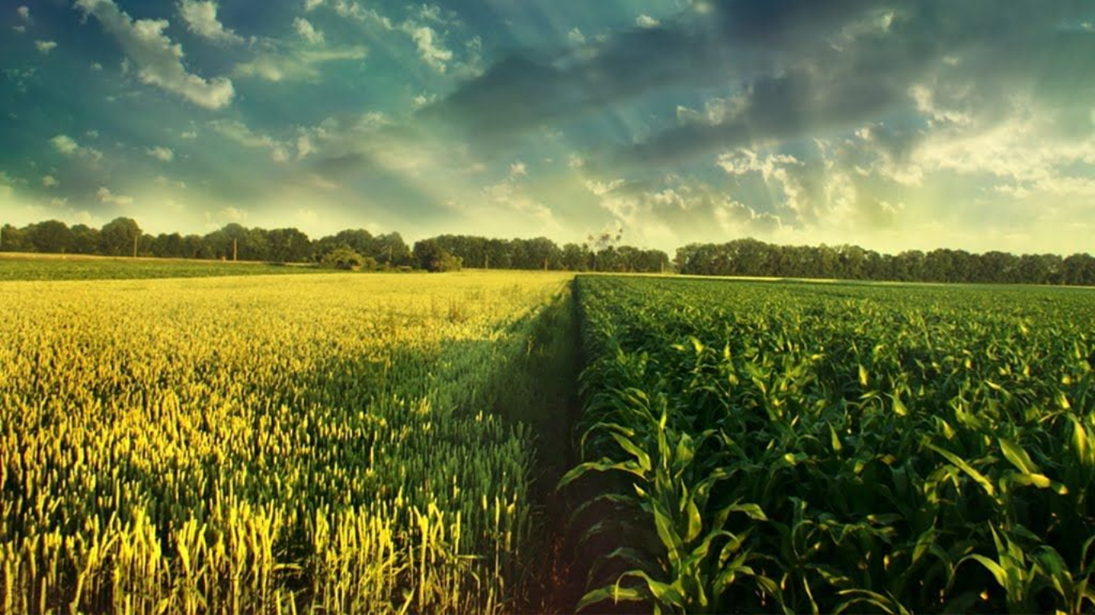
Guide Name MRS. S B PRIYA M.TECH.,
Camera vision Based Animal Beat Back System For Agriculture using Machine Learning
Presented By:
Kokila Vani M
Thamaraiselvi M
Priyanka R
Priya Dharshini M

Slide 2
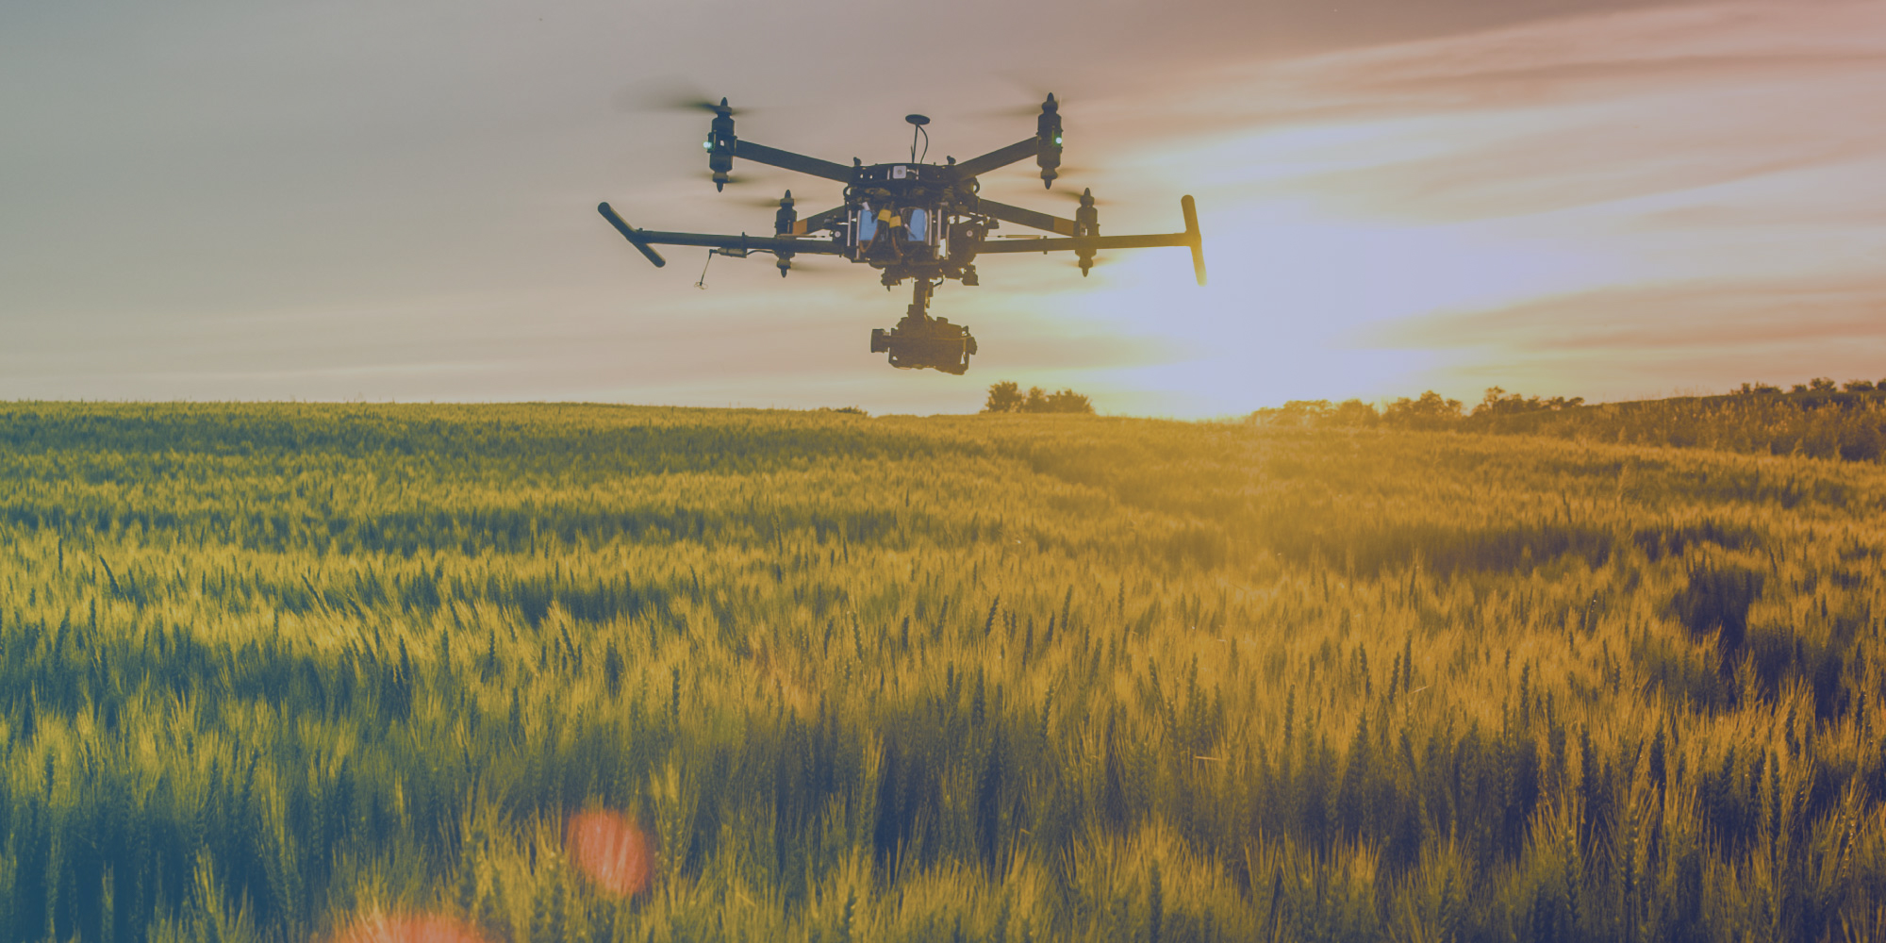
Objective
To design, development and assessment of an intelligent animal intruding detection and repelling system for crop protection based on AI.
To identify animals fastly.
To repel them using ultrasound
To alert the farmers

Slide 3
Problem Statement
One of the main concerns of today's farmers is protecting crops from domestic and wild animals attacks.
There are different traditional approaches to address this problem which can be lethal (e.g., shooting, trapping) and non-lethal (e.g., scarecrow, chemical repellents, organic substances, mesh, or electric fences).
Very expensive with high maintenance costs

Slide 4
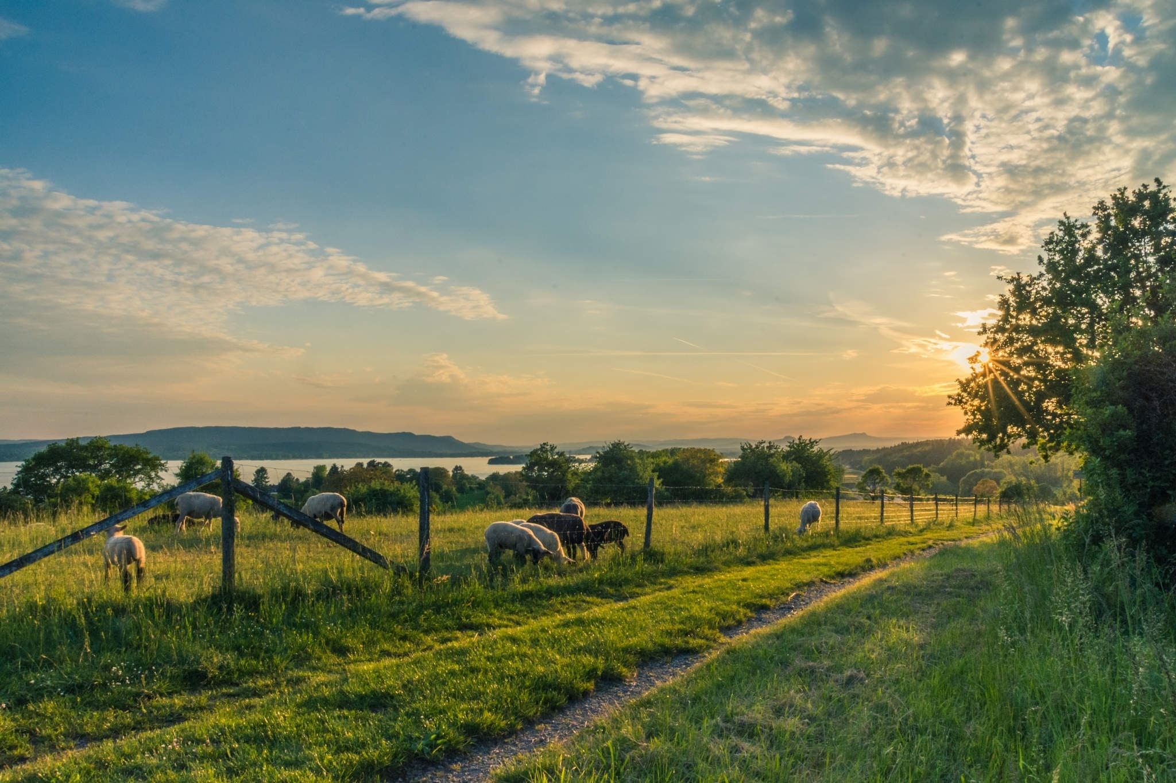
ABSTRACT
Agriculture automation has been on the rise leveraging.
One of the main concerns of today's farmers is protecting crops from wild animals’ attacks.
Develop a system, that combines AI Computer Vision using FRCNN for detecting and recognizing animal species, and specific ultrasound emission (i.e., different for each species) for repelling them.
FRCNN model to identify the 90 different animals provided in the data set. Finally, train and test the FRCNN model and visualize the results by plotting the confusion matrix.
Alert the farmers by sending SMS.

Slide 5
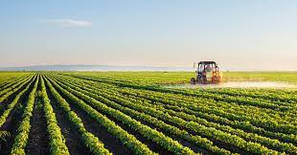
LITEREATURE SURVEY
Year | Title | Author | Methods/Overview | Merits | Demerits
2021 | Monitoring the Movements of Wild Animals and Alert System using Deep Learning Algorithm | Y A Roopashree; M Bhoomika; R Priyanka; K Nisarga; Sagarika Behera | Deep Learning method is used here for animal detection and classification. | Predict Accurately | application trained for two datasets, tiger and elephant.
2021 | SocialCattle: IoT-based Mastitis Detection and Control through Social Cattle Behavior Sensing in Smart Farms | Yunhe Feng; Haoran Niu; Fanqi Wang; Susan Ivey; Jayne Wu; Hairong Qi; Raul Almeida; Shigetoshi Eda; Qing Cao | To monitor cow social behaviors to deploy portable GPS devices on cows to track their movement trajectories and contacts with each other. | Monitor and track the cow effectively | Predict cows only

Slide 6
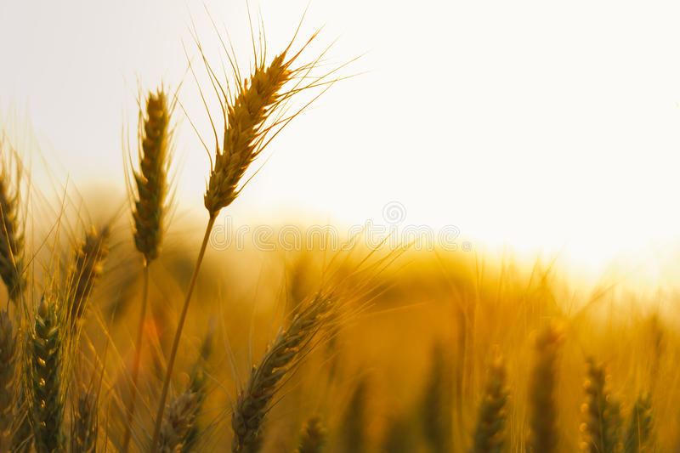
Year | Title | Author | Methods/Overview | Merits | Demerits
2021 | Workflow and convolutional neural network for automated identification of animal sounds | Zachary J.Ruff, Damon B.Lesmeister | RStudio using the Shiny package, creating a portable and user-friendly way for field biologists and managers to efficiently process audio data and detect these target species | Accuracy is high. Minimal delays using consumer-grade computers | High power to detect these species. Combined with a low proportion of false positives.
Year | Title | Author | Methods/Overview | Merits | Demerits
2020 | Real-Time Monitoring of Agricultural Land with Crop Prediction and Animal Intrusion Prevention using Internet of Things and Machine Learning at Edge | R. Nikhil; B.S. Anisha; Ramakanth Kumar P. | use of IOT and Automation there by achieving significant progress in irrigation | There is no harm to the ecosystem. No disruption to humans | Lacks in monitoring. Accuracy is low.

Slide 7
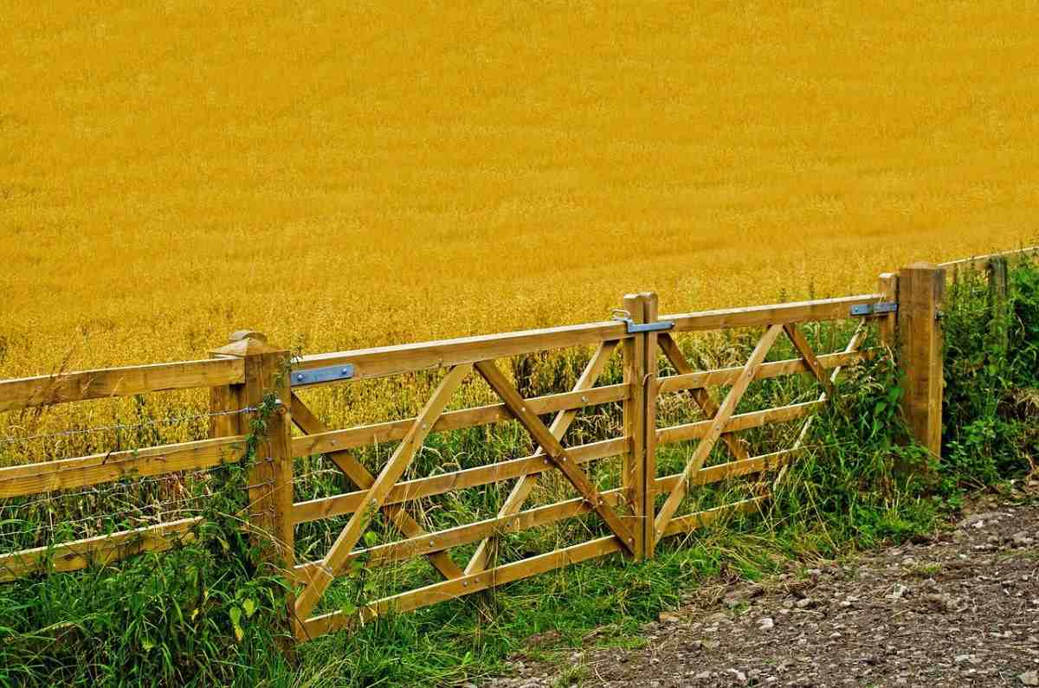
Existing system
Wild animals are a special challenge for farmers throughout the world. Animals such as deer, wild boars, rabbits, moles, elephants, monkeys, and many others may cause serious damage to crops.
1. Agricultural fences
2. Natural Repellents
3. Chemical repellents
4. Biophysical barriers; fences

Slide 8
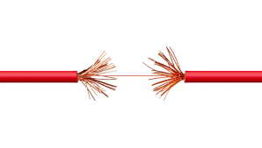
Disadvantages
Its disadvantages include the potential for the entire fence to be disabled due to a break in the conducting wire, shorting out if the conducting wire contacts any non- electrified component that may make up the rest of the fence, power failure, or forced disconnection due to the risk of fires starting by dry vegetation touching an electrified wire.

Slide 9

PROPOSED SYSTEM
AI Computer Vision for detecting animal species, and specific ultrasound emission (i.e., different for each species) for repelling them.
RNN-used to detect animal
Deep Convolutional Neural Network – recognize the animal and label them Repellent Module-to play ultrasound and repel the animal.
Notify the farmers with dataset

Slide 10

Advantages
Wide area surveillance
Accurate and Fast prediction
Cost effectiveness of available Crop protection systems.
Easy to use and with less maintenance.
Robust and reliable system.
Complete security or full proof system.

Slide 11

Software Specification
Server Side : Python 3.7.4(64-bit) or (32-bit)
Client Side : HTML, CSS, Bootstrap
IDE : Flask 1.1.1
Back end : MySQL 5.
Server : Wampserver 2i
DL DLL : TensorFlow, Pandas, SiKit Learn

Slide 12
System Architecture

Slide 13
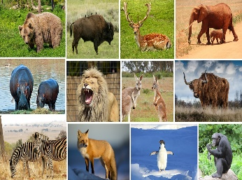
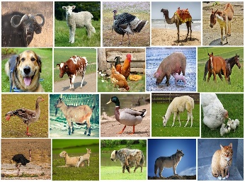
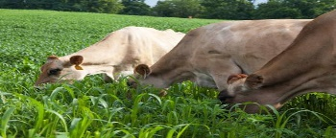
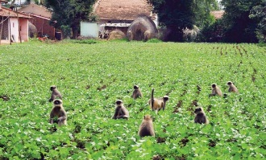



Algorithm Flow
Test Sample
Animal Dataset
DL Model
DL Model
Preprocessing
Capture Live Frame
Segmentation
Preprocessing
Feature Extraction
Segmentation
Classification
Feature Extraction
Animal Not Found
Matching
Animal Found
Animal Type
Repellent Sound
Alert Farmer
Repellent
Farmer

Slide 14
Modules List
1 Animal Repellant Web Control Panel
2 DL Model
2.1. Training & Test Data Annotation
2.2. Pre processing
2.3. Animal Detection
2.4. Feature Extraction
2.5. Animal Type Classification
2.6. Prediction
3 Repellent Integration
4 Alert Generator
5 Performance Analysis

Slide 15
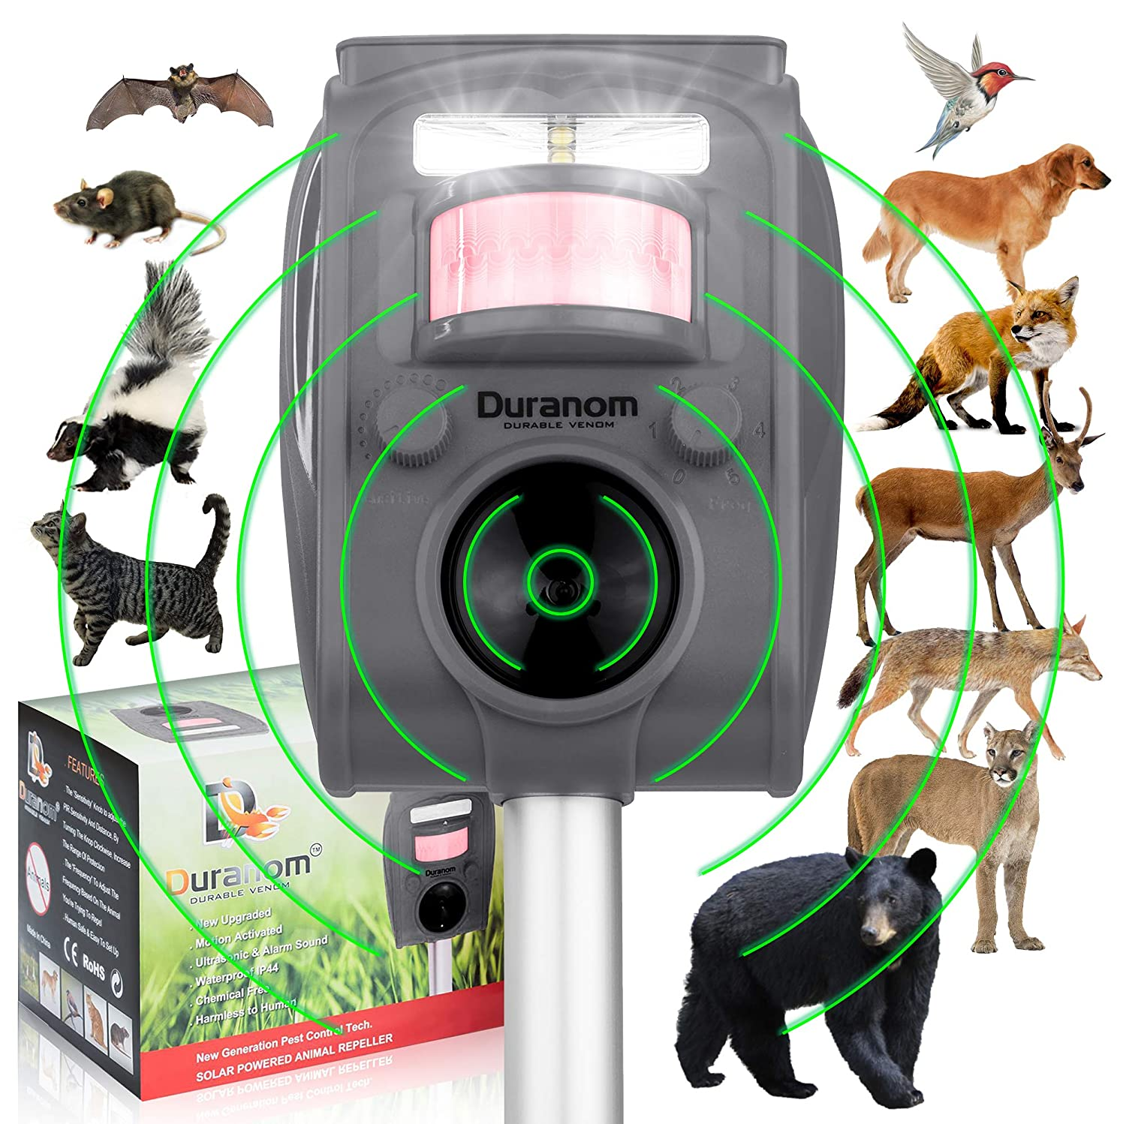
Modules Description
1 Animal Repellent Web Dashboard
This system works in real time to detect the animals in the fields.
The system enables the farmer to have a real time view of his fields from any place via internet and even provides manual buzzer controls if the need arises to use them.

Slide 16
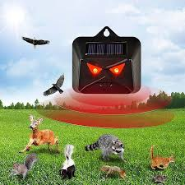
2 DL Model
2.1. Training & Test Data Annotation
This module begins by annotation of animal dataset
2.2. Preprocessing
Read image
RGB to Grey Scale conversion
2.3. Animal Detection
Therefore, in this module, Region Proposal Network (RPN) generates RoIs by sliding windows on the feature map and different aspect ratios.
2.4. Feature Extraction
After the animal detection, animal image is given as input to the feature extraction module to find the key features and used for classification.
2.5. Animal Type Classification
DCNN algorithms were implemented to automatically detect and reject improper animal images during the classification process.

Slide 17
3.Repellent Integration
Monitoring window detecting the presence of animals then it enables repellent module to repelling them through the generation of ultrasounds, which has recently been proven as an alternative, effective method for protecting crops against predicted animals.
They can hear sounds having lower frequencies with respect to the human ear.
For instance, while the audible range for humans is from 64Hz - 23KHz, the corresponding range of goats, sheep, domestic pigs, dogs and cats is 78Hz - 37KHz, 10Hz - 30KHz, 42Hz - 40.5KHz 67Hz - 45KHz and 45Hz - 64KHz respectively.

Slide 18

4.Alert Generator
The sms notification consisting of captured image is notified to the user regarding the detected motion in this phase.
The sms is sent to the web UI account of the user to the registered number.

Slide 19
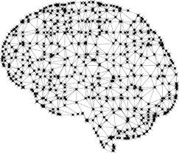
5.Performance Analysis
In this module able to find the performance of our system using SENSITIVITY, SPECIFICITY AND ACCURACY of Data in the datasets are divided into two classes not animal (the negative class) and animal and types (the positive class).

Slide 20
Flow Chart

Slide 21

Conclusion
Agricultural farm security is widely needed technology nowadays.
In order to accomplish this, a vision based system is proposed and implemented Animal Repellent using Python and Open CV to blow out the animals.
The performance of the proposed system has been analyzed with respective to the captured images of the intruder and notification alert.
Using this proposed model, anyone can detect any type of intrusion around the field effectively.

Slide 22

FUTURE ENHANCEMENT
Further in the proposed architecture, some image compression techniques can be developed to reduce the time taken for notification to reach user as described above.

Slide 23
REFERENCES
M. De Clercq, A. Vats, and A. Biel, ``Agriculture 4.0: The future of farming technology,'' in Proc. World Government Summit, Dubai, UAE, 2018, pp. 11-13.
[2] Y. Liu, X. Ma, L. Shu, G. P. Hancke, and A. M. Abu-Mahfouz, ``From industry 4.0 to agriculture 4.0: Current status, enabling technologies, and research challenges,'' IEEE Trans. Ind. Informat., vol. 17, no. 6, pp. 43224334, Jun. 2021.
[3] M. S. Farooq, S. Riaz, A. Abid, K. Abid, and M. A. Naeem, ``A survey on the role of IoT in agriculture for the implementation of smart farming,‘’ IEEE Access, vol. 7, pp. 156237-56271, 2019.
[4] K. Kirkpatrick, ``Technologizing agriculture,'' Commun. ACM, vol. 62, no. 2, pp. 1416, Jan. 2019.
[5] A. Farooq, J. Hu, and X. Jia, ``Analysis of spectral bands and spatial resolutions for weed classification via deep convolutional neural network,‘’ IEEE Geosci. Remote Sens. Lett., vol. 16, no. 2, pp. 183-187, Feb. 2018.

Slide 24


